Slide 1
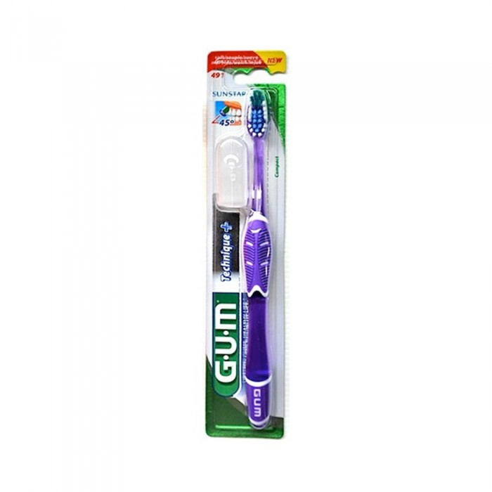
Gum Toothbrush 491 Compact Soft
1 pill
23.00 SAR. Q
How to use brush and paste?
Grab the brush in a comfortable and tight way.
Start brushing with the top jaw.
Move the brush from above beneath.
Go to brush the lower jaw while moving the brush from under the top.
Brush the teeth from the outside and then from the inside and then go for the cutters.
Don't also forget to brush the tongue or use a tongue cleaning brush.

Slide 2
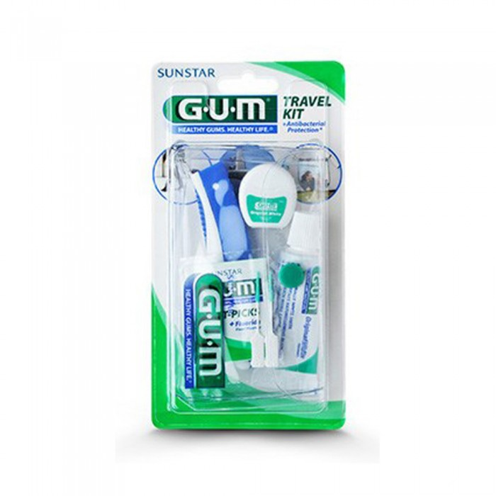
JOM
Jum Travel Group 156 Natural Whiteness
1 pill
33.35 SAR. Q
Travel set has 12.5ml white original toothpaste, travel toothbrush, 10m original white thread, 2 soft sticks for interdental cleaning
First toothpaste.
It has been scientifically proven to be effective on the teeth as it effectively removes dyes and works to strengthen the gums and teeth and prevents the re-emergence of dyes
- Second toothbrush
Folding toothbrush with bristles that remove dyes from the teeth and prevent the growth of bacteria which keeps them and makes their use longer
- Third dental thread
It is a thread made of silicone and fluorine flour which helps to clean the teeth well and make them very white and prevents stench
- IV Soft Sticks
They are easy to use to clean between teeth and make them white and without stench

Slide 3
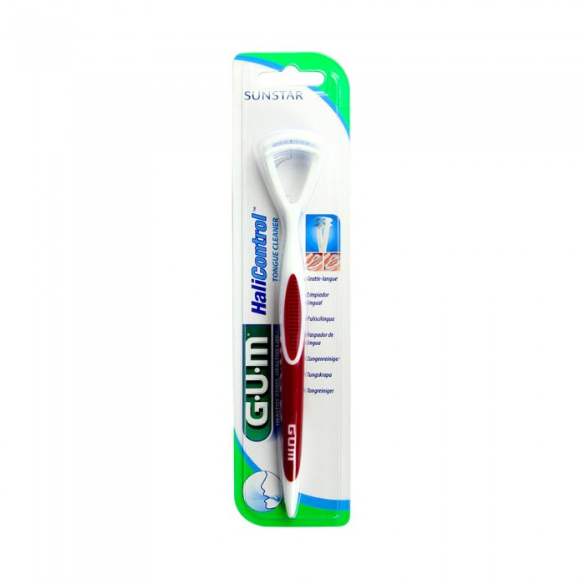
JOM
JUM Tongue Cleaner Halicentrol 720 - 1pill
1 pill
23.00 SAR. Q

Slide 4
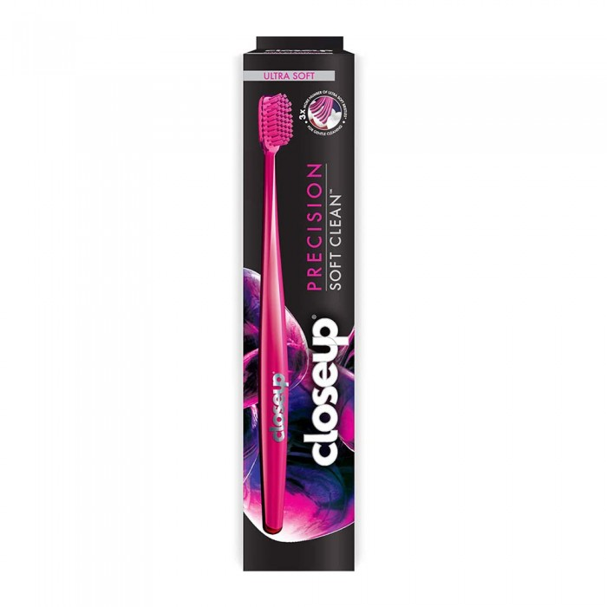
Closs Up
Closs Up Super Soft Bristle Toothbrush
1 pill
SAR 19.00. Q
- This brush removes up to 90% surface stains to reveal a brighter smile, and also has a distinctive design and perfect curves for bristles to be as a stain eraser.
- It has multi-level bristles to remove plaque and food from the teeth to prevent tooth decay too, and it has very soft bristles for clean and healthy gums.

